Slide 1

7 Most Common Computer & Laptop Problems with Solution

Slide 2
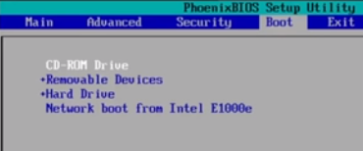
1#: Most Common Problem with Solution:
Windows Installation is Necessary for Every One
DVD
USB (.iso file)
Rufus
Power ISO
Ultra ISO
Windows USB/DVD Tool

Slide 3
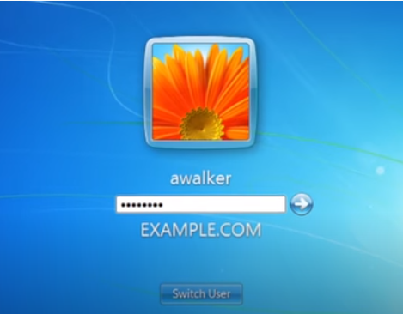
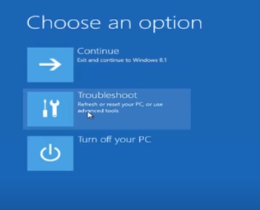
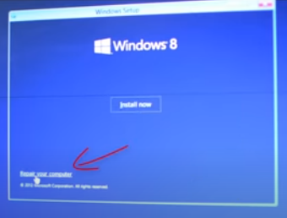
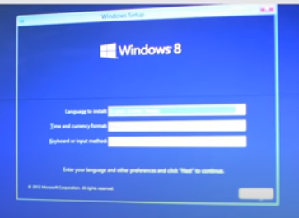
2#: Most Common Problem with Solution:
Operating System Password Lost
Either New OS Install ( Your Desktop Data is Removed)
Then use Win PE7 for this Solution
How to Reset your Password with OS
Reset your PC
CMD Commands
Software also that Crack Your Password but they Paid

Slide 4
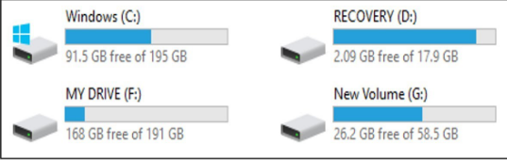
3#: Most Common Problem with Solution:
Hard Disk Partitions (OS installation or Gparted)
System Partition
Recovery Partition
Primary Partition
Extended Partition
Logical Partition
Dynamic Partition

Slide 5



4#: Most Common Problem with Solution:
After Operating System Installation Drivers Issue
Best Solution Company Website and Download it
Driver Booster
Driver Pack Solution

Slide 6
5#: Most Common Problem with Solution:
Data Recovery
Deleted Data
Format Partition
Disk Drill PRO
Data Rescue 5 for Windows
R-Studio
Stellar Data Recovery
EaseUS Data Recovery
Disk Drill
PhotoRec
TestDisk
Recuva
Wondershare Recoverit
Paid Software's
Free Software's

Slide 7
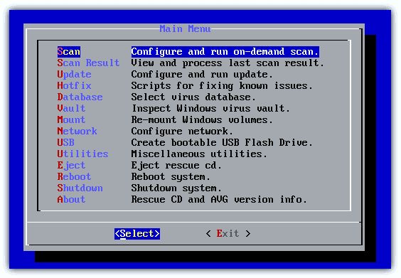
6#: Most Common Problem with Solution:
Slow Down Computer Speed
Major Factor Virus
Avast Rescue Disk
Kaspersky Rescue Disk
AVG Rescue CD
ESET Rescue Disk
Dr. Web Live Disk

Slide 8
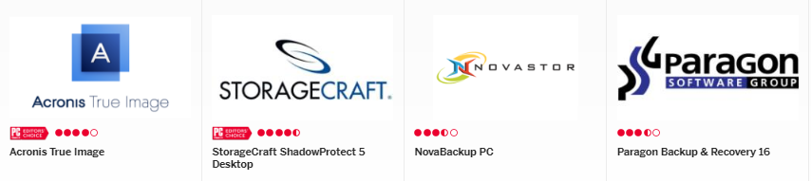
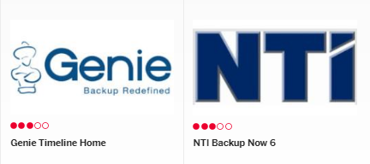
7#: Most Common Problem with Solution:
Backup to Data as Well as Partition Restore All Your System Setting

